Slide 1

Machine Learning with Graphs III
Yeshwant Singh
yeshwant.singh@ddn.upes.ac.in
SoCS, UPES, Dehradun

Slide 2
Outline
Recap – Motivation behind GNN
Graph Convolutional Network (GCN)
Relational GCN
Message Passing (Python)
GCN using Numpy

Slide 3
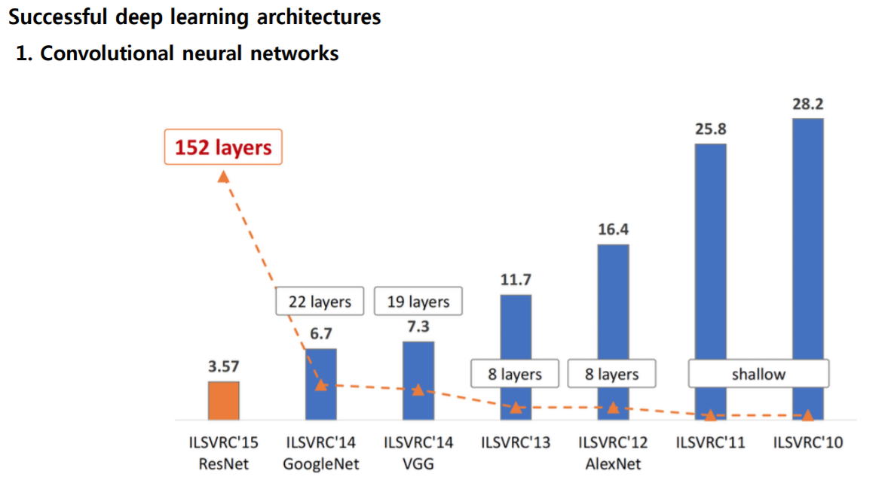
Recap – Motivation

Slide 4
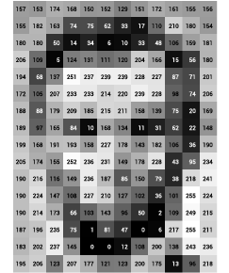
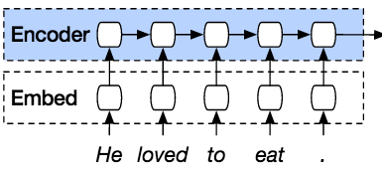
Recap – Motivation
Non-Euclidean data structure
Data structures of shown examples are regular

Slide 5
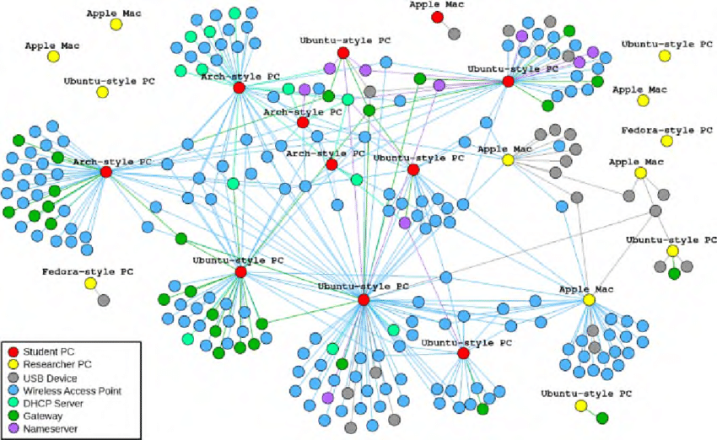
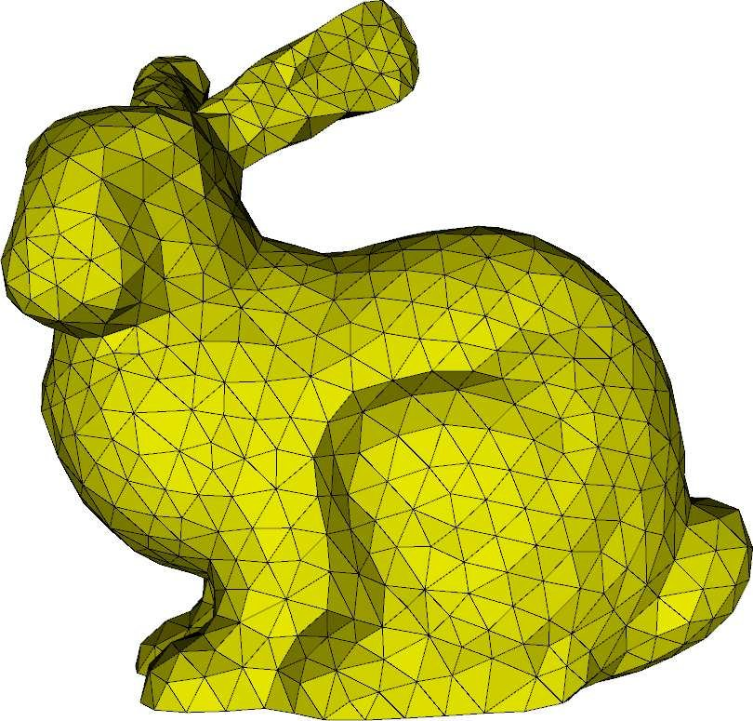
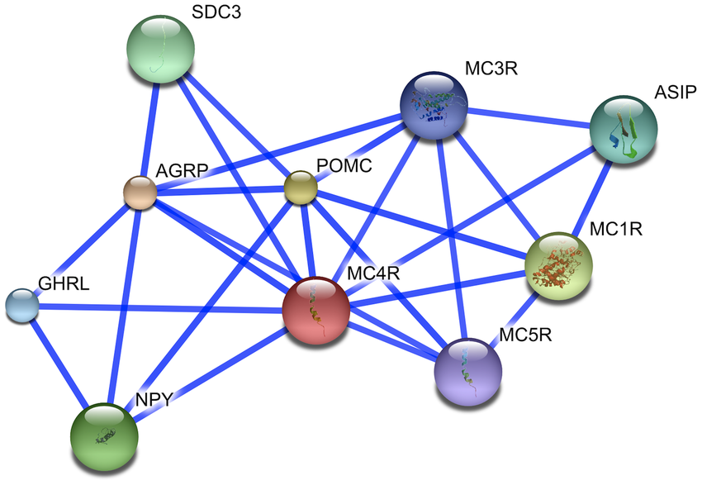
Recap – Motivation
Non-Euclidean data structure
However, there are many irregular data structures
Geometric Network Graph
Social Network Graph
Molecule Network Graph

Slide 6
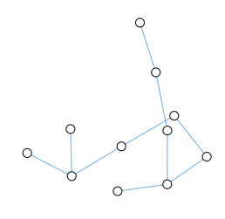
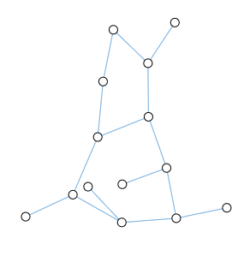
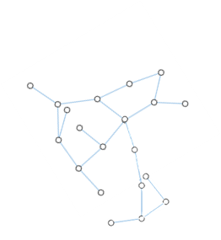
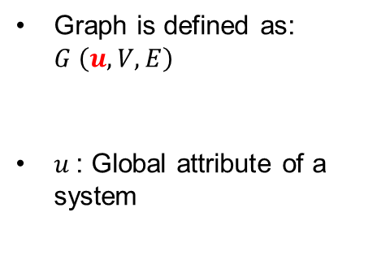
Global Features
Graph is defined as: $G \left(u, V, E\right)$
$u$: Global attribute of a system
Predict whether it binds to certain receptor – implicate diseases?
Figure from https://www.frontiersin.org/articles/10.3389/fgene.2021.690049/full

Slide 7
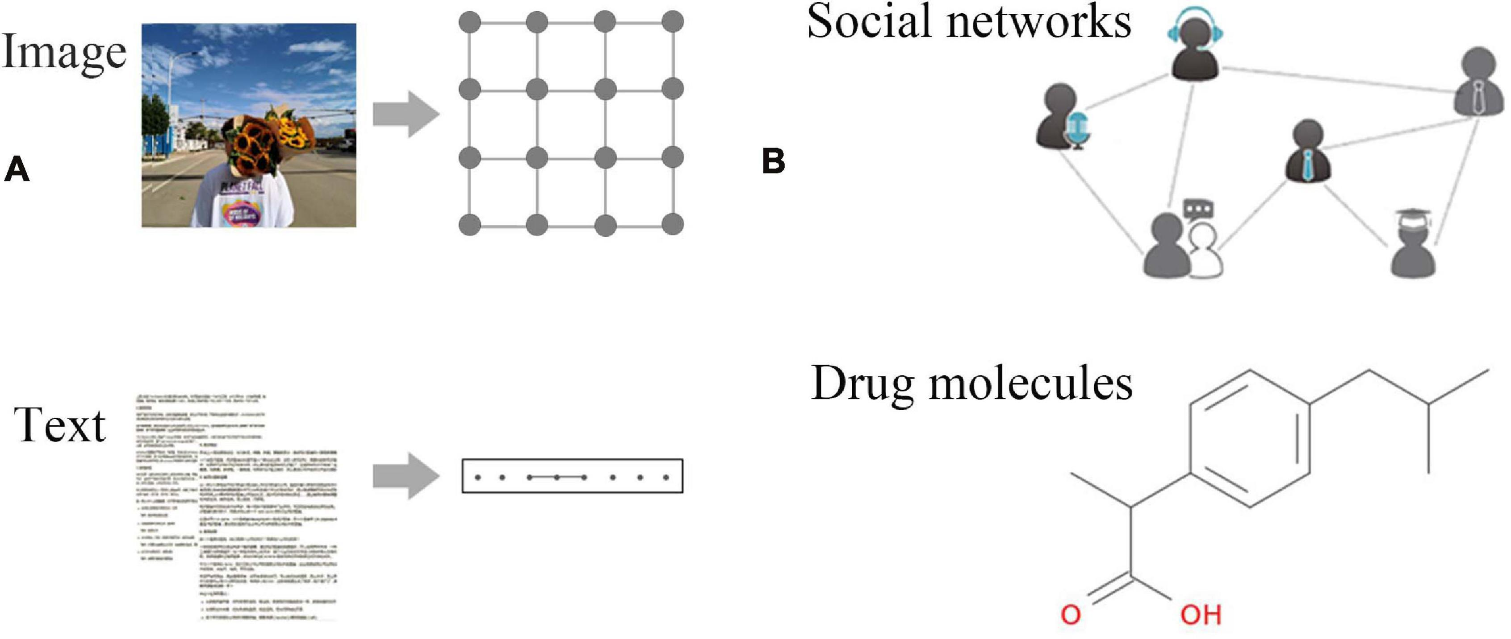
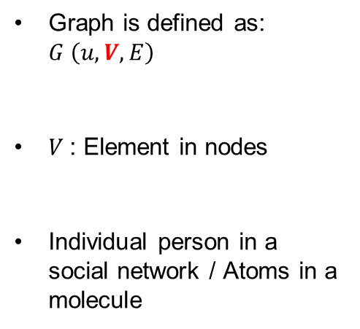
Node Features
Graph is defined as: $G \left(u, V, E\right)$
$V$: Element in nodes
Individual person in a social network / Atoms in a molecule
Figure from https://www.frontiersin.org/articles/10.3389/fgene.2021.690049/full

Slide 8


Node Features
Siti
• 22 years old
• Male
• Malaysia
• Part time student
…
Kalaimani
• 25 years old
• Female
• Indian
• Full time student
…
Tyler Khoo
• 21 years old
• Male
• China
• Full time student
…

Slide 9
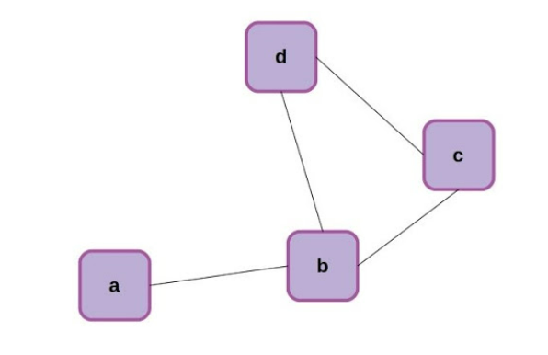
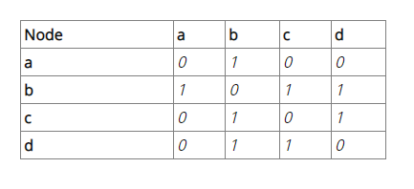
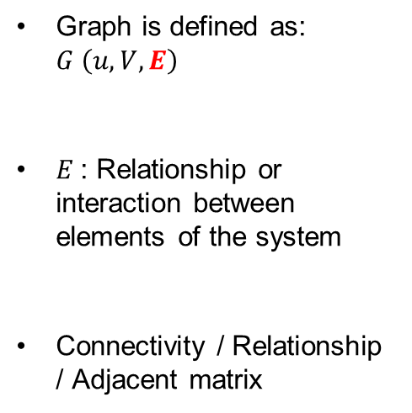
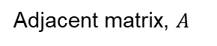
Edge Features
Adjacent matrix, $A$
Graph is defined as: $G \left(u, V, E\right)$
$E$: Relationship or interaction between elements of the system
Connectivity / Relationship / Adjacent matrix
Figure form https://www.kdnuggets.com/2020/11/friendly-introduction-graph-neural-networks.html

Slide 10
Edge Features
classmate
friend
siblings
married
Figure form https://www.kdnuggets.com/2020/11/friendly-introduction-graph-neural-networks.html

Slide 11
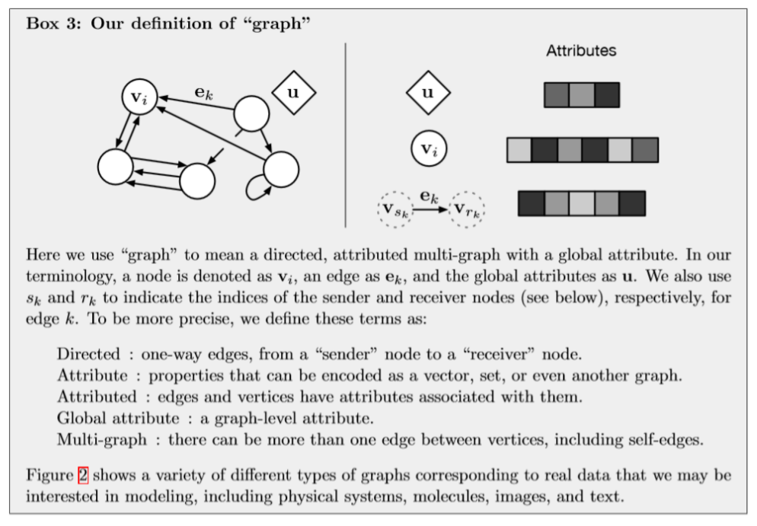
Graph Network Terminology
Battaglia, Peter W., et al. "Relational inductive biases, deep learning, and graph networks." arXiv preprint arXiv:1806.01261 (2018).

Slide 12
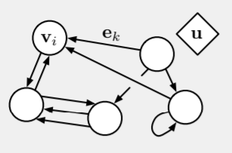
Graph Network Framework
The main unit of computation in the GN framework is the GN block, a “graph-to-graph” module.
Input - Graph
Output - Graph
performs computations over the structure
GN block
GN block
Entities are represented by the graph’s nodes, relations by the edges, and system-level properties by global attributes.

Slide 13
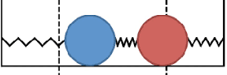
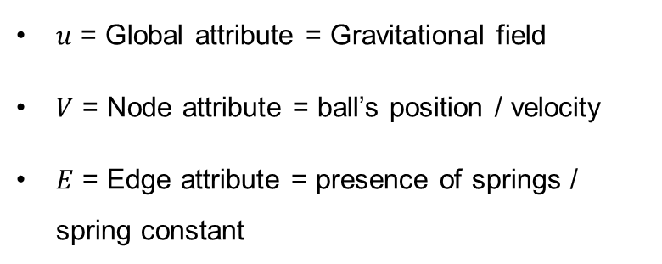
Graph Network Framework
Take for example: To predict the movements a set of rubber balls in an arbitrary gravitational field, where each have one or more springs which connect them to some of the others
$u$ = Global attribute = Gravitational field
$V$ = Node attribute = ball’s position / velocity
$E$ = Edge attribute = presence of springs / spring constant

Slide 14
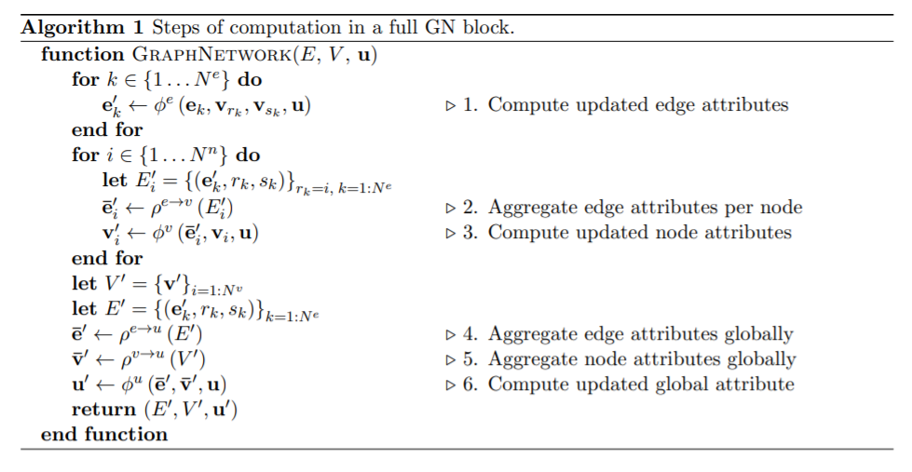
GN Block

Slide 15
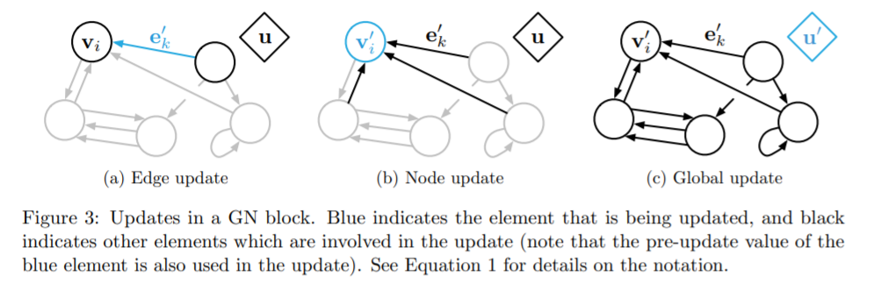
GN Block
Update edge based on current edge, node, and global context. Repeat for all edge

Slide 16
GN Block
Aggregate edge attribute per node
Update node based on updated edge, current node and global context. Repeat for all nodes.

Slide 17
GN Block
Aggregate all the updated edge and node globally.
Update global context based on updated aggregated edge, node and current global context

Slide 18
GN Block
Edge update : relationship or interactions, sometimes called as ‘message passing’
ie. the forces of spring
Node update : aggregates the edge updates and used in the node update
ie. the forces acting on the ball
Global update : an update for the global attribute
ie. the net forces and total energy of the physical system

Slide 19
Graph Convolutional Network
Notes:
https://www.youtube.com/watch?v=2KRAOZIULzw&ab_channel=WelcomeAIOverlords

Slide 20
Examples
GCN Layer 1
Aggregate (Neighbours)
Take into account of your neighbour information
Neural Network
Output

Slide 21
Examples
Represent the information into a vector
1 | 0 | 1 | 1 | 2 | 1
1 | 0 | 1 | 1 | 1 | 2
1 | 1 | 0 | 0 | 0 | 3
0 | 0 | 0 | 2 | 2 | 1
0 | 0 | 0 | 2 | 2 | 1

Slide 22
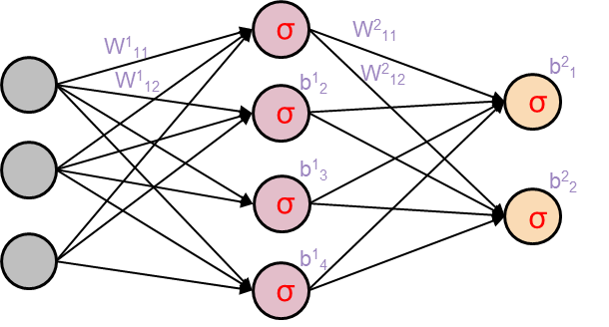
Examples - Aggregation
Mean( ) =
1 | 0 | 1 | 1 | 2 | 1
1 | 1 | 0 | 0 | 0 | 3
1 | 3 | 0
0 | 0 | 0 | 2 | 2 | 1
Aggregated node
Mean/sum/ weighted sum/etc
1 | 0 | 1 | 1 | 1 | 2
Updated node
NN
1 | 0 | 1 | 1 | 2 | 1
1 | 0 | 1 | 1 | 1 | 2
1 | 1 | 0 | 0 | 0 | 3
0 | 0 | 0 | 2 | 2 | 1
0 | 0 | 0 | 2 | 2 | 1

Slide 23
Examples - Updated
1 | 1 | 1 | 2 | 2 | 3
1 | 3 | 0
NN
1 | 3 | 0

Slide 24
Examples - Aggregation
Mean( ) =
1 | 0 | 1 | 1 | 2 | 1
0 | 0 | 0 | 2 | 2 | 1
4 | 0 | 1
0 | 0 | 0 | 2 | 2 | 1
Aggregated node
Updated node
NN
1 | 0 | 1 | 1 | 2 | 1
1 | 0 | 1 | 1 | 1 | 2
1 | 1 | 0 | 0 | 0 | 3
0 | 0 | 0 | 2 | 2 | 1
0 | 0 | 0 | 2 | 2 | 1

Slide 25
Examples - Updated
1 | 0 | 1 | 2 | 2 | 1
4 | 0 | 1
Aggregated node
Updated node
NN
1 | 3 | 0
4 | 0 | 1

Slide 26
Examples - Aggregation
Mean( ) =
1 | 0 | 1 | 1 | 1 | 2
0 | 0 | 0 | 2 | 2 | 1
2 | 1 | 3
0 | 0 | 0 | 2 | 2 | 1
Aggregated node
Updated node
NN
1 | 0 | 1 | 1 | 2 | 1
1 | 0 | 1 | 1 | 1 | 2
1 | 1 | 0 | 0 | 0 | 3
0 | 0 | 0 | 2 | 2 | 1
0 | 0 | 0 | 2 | 2 | 1

Slide 27
Examples - Updated
1 | 0 | 1 | 2 | 2 | 2
2 | 1 | 3
Aggregated node
Updated node
NN
1 | 3 | 0
4 | 0 | 1
2 | 1 | 3

Slide 28
Examples – Repeat the rest
1 | 0 | 1 | 2 | 2 | 2
2 | 1 | 3
Aggregated node
Updated node
NN
1 | 3 | 0
1 | 0 | 0
4 | 0 | 1
1 | 1 | 1
2 | 1 | 3

Slide 29
Examples
GCN Layer 1
Aggregate (Neighbours)
Neural Network
Output

Slide 30
Examples
GCN Layer 1
Aggregate (Neighbours)
Neural Network
Hidden layer
Aggregate (Neighbours)
GCN Layer 2: Repeat the same process but input is the output of GCN layer 1
Neural Network
Output

Slide 31
Examples – Who is a singer?
Siti
• 22 years old
• Female
• Malaysia
• # of followers
…
Tyler Khoo
• 21 years old
• Male
• China
• # of followers
…
Kalaimani
• 25 years old
• Female
• Indian
• # of followers
…

Slide 32
Examples
Represent the information into a vector

Slide 33
Examples – Design 1
GCN Layer 1
Aggregate (Neighbours)
Output (Singer / Not Singer)
Just considering neighbour from 1 distance away

Slide 34
Examples – Design 2
GCN Layer 1
Aggregate (Neighbours)
Hidden state

Slide 35
Examples – Design 2
Represent the information into a vector

Slide 36
Examples – Design 2
GCN Layer 1
Aggregate (Neighbours)
Hidden state
GCN Layer 2
Aggregate (Hidden state)
Considering neighbour from 2 distance away
Output (Singer / Non Singer)

Slide 37
Examples – Who is a singer?
Output: Singer / Non-Singer
Siti
• 22 years old
• Female
• Malaysia
• # of followers
…
Tyler Khoo
• 21 years old
• Male
• China
• # of followers
…
Kalaimani
• 25 years old
• Female
• Indian
• # of followers
…

Slide 38
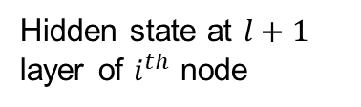
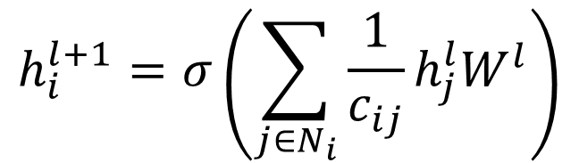
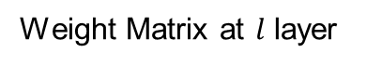
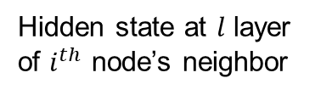
Updated function
Weight Matrix at $l$ layer
Activation function
$$h_{i}^{l+1}=σ\left(\sum_{j∈N_{i}}{\frac{1}{c_{ij}}h_{j}^{l}W^{l}}\right)$$
Hidden state at $l+1$ layer of $i^{th}$ node
Normalizing factor
Hidden state at $l$ layer of $i^{th}$ node’s neighbor

Slide 39
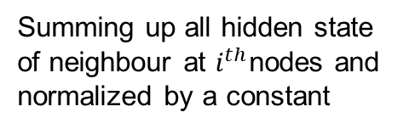
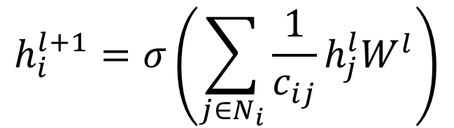
Updated function
Aggregate (Neighbours)
$$h_{i}^{l+1}=σ\left(\sum_{j∈N_{i}}{\frac{1}{c_{ij}}h_{j}^{l}W^{l}}\right)$$
GCN Layer 1
Summing up all hidden state of neighbour at $i^{th}$nodes and normalized by a constant

Slide 40
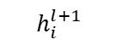
Updated function
Aggregate (Neighbours)
$$h_{i}^{l+1}=σ\left(\sum_{j∈N_{i}}{\frac{1}{c_{ij}}h_{j}^{l}W^{l}}\right)$$
GCN Layer 1
$$h_{i}^{l+1}$$
Hidden state
Linear projection matrix

Slide 41
Updated function
Aggregate (Neighbours)
$$h_{i}^{l+1}=σ\left(\sum_{j∈N_{i}}{\frac{1}{c_{ij}}h_{j}^{l}W^{l}}\right)$$
GCN Layer 1
$$h_{i}^{l+1}$$
Hidden state
Pass through an activation function

Slide 42
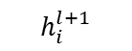
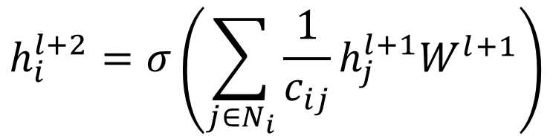
Updated function
Aggregate (Neighbours)
GCN Layer 1
$$h_{i}^{l+1}$$
Hidden state
Aggregate (Hidden state)
$$h_{i}^{l+2}=σ\left(\sum_{j∈N_{i}}{\frac{1}{c_{ij}}h_{j}^{l+1}W^{l+1}}\right)$$
GCN Layer 2
Output (Singer / Non Singer)

Slide 43
Examples – Design 3
GCN Layer 1
By having more GCN Layer, message is passing to further neighbours.
GCN Layer 2
GCN Layer 3
Just now, we just considering that the one type of node and link. Sometimes, in reality, types of nodes and link can be different. I.e. Perhaps some connection is more important → Relational Graph Neural Network
GCN Layer 4

Slide 44
Relational Graph Convolutional Network
Notes:
https://www.youtube.com/watch?v=2KRAOZIULzw&ab_channel=WelcomeAIOverlords

Slide 45
Examples – Relational GCN
Twitter Account 1
Follow
Twitter Account 2
Type:
Node = Account / Tweet
Link = Follower / Retweet
Twitter Account 1
Retweet
Twitter Content
RGCN can be used to handle this heterogenous graph

Slide 46
Examples – Relational GCN
Twitter Account 1
Follow
Twitter Account 2
Type:
Node = Account / Tweet
Link = Follow / Block / Retweet
Twitter Account 3
Block
Twitter Account 2
Twitter Account 1
Retweet
Twitter Content
RGCN can be used to handle this heterogenous graph

Slide 47
Examples – Relational GCN
GCN Layer 1
Aggregate (Neighbours)
Neural Network
Output
Doesn’t make sense to aggregate (mean / sum) in Relational GCN
Why?
Follow
Twitter Account 1
Twitter Account 2
Block
Twitter Account 3

Slide 48
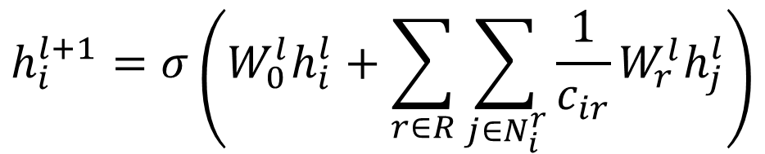
Examples – Relational GCN
To solve this – we will have different weight matrix for different connections
Twitter Account 1
Follow
Twitter Account 2
Block
Twitter Account 3
$$h_{i}^{l+1}=σ\left(W_{0}^{l}h_{i}^{l}+\sum_{r∈R}{\sum_{j∈N_{i}^{r}}{\frac{1}{c_{ir}}W_{r}^{l}h_{j}^{l}}}\right)$$
Each relation type has a projection matrix

Slide 49
Examples – Relational GCN
To solve this – we will have different weight matrix for different connections
Twitter Account 1
Follow
Twitter Account 2
Block
Twitter Account 3
$$h_{i}^{l+1}=σ\left(W_{0}^{l}h_{i}^{l}+\sum_{r∈R}{\sum_{j∈N_{i}^{r}}{\frac{1}{c_{ir}}W_{r}^{l}h_{j}^{l}}}\right)$$
Special Weight Matrix for self node

Slide 50

GCN vs Relational GCN
RGCN has more parameters than GCN
Each relation type has it own Weight
Problem – if we have more relation type . To solve this, we get around it by regularization
Basis decomposition – Here, we set the unique number of W we want in the layer. Each of the W is calculated via the linear combination of coefficient for each components [weight sharing scheme]
$$W_{r}^{l}=\sum_{b=1}{a_{rb}^{l}V_{b}^{l}}$$

Slide 51
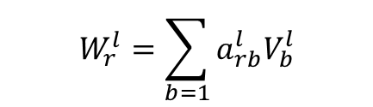
Relational GCN
Weight sharing scheme
$$Coefficient= +1$$
Twitter Account 1
Follow
Twitter Account 2
$$W_{r}^{l}=\sum_{b=1}{a_{rb}^{l}V_{b}^{l}}$$
Block
Twitter Account 3
$$Coefficient=−1$$

Slide 52
Simple Massage Passing
Notes:
https://www.youtube.com/watch?v=2KRAOZIULzw&ab_channel=WelcomeAIOverlords

Slide 53
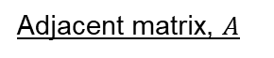
Simple Massage Passing
Key concept to pass massage to neighbour nodes using adjacent matrix
5
Adjacent matrix, $A$
 | 1 | 2 | 3 | 4 | 5
1 | 0 | 1 | 0 | 0 | 0
2
3
4
5
3
4
1
2

Slide 54
Simple Massage Passing
Key concept to pass massage to neighbour nodes using adjacent matrix
Your turn to fill up the rest
5
Adjacent matrix, $A$
 | 1 | 2 | 3 | 4 | 5
1 | 0 | 1 | 0 | 0 | 0
2 | 1 | 0 | 1 | 0 | 0
3
4
5
3
4
1
2

Slide 55
Simple Massage Passing
Key concept to pass massage to neighbour nodes using adjacent matrix
5
Adjacent matrix, $A$
 | 1 | 2 | 3 | 4 | 5
1 | 0 | 1 | 0 | 0 | 0
2 | 1 | 0 | 1 | 0 | 0
3 | 0 | 1 | 0 | 1 | 1
4 | 0 | 0 | 1 | 0 | 0
5 | 0 | 0 | 1 | 0 | 0
3
4
1
2

Slide 56
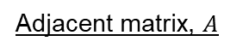
Simple Massage Passing
Something to notice
Matrix is symmetric – due to undirected edges
Sum across the row and columns → number of incoming and outgoing edges of each nodes → called degree of nodes
Adjacent matrix, $A$
 | 1 | 2 | 3 | 4 | 5 | Sum
1 | 0 | 1 | 0 | 0 | 0 | 1
2 | 1 | 0 | 1 | 0 | 0 | 2
3 | 0 | 1 | 0 | 1 | 1 | 3
4 | 0 | 0 | 1 | 0 | 0 | 1
5 | 0 | 0 | 1 | 0 | 0 | 1
Sum | 1 | 2 | 3 | 1 | 1

Slide 57
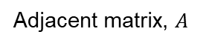
Simple Massage Passing
Now we multiply adjacent matrix with node value
0 | 1 | 0 | 0 | 0
1 | 0 | 1 | 0 | 0
0 | 1 | 0 | 1 | 1
0 | 0 | 1 | 0 | 0
0 | 0 | 1 | 0 | 0
1
2
3
4
5
=
Adjacent matrix, $A$
Feature Vector

Slide 58
Simple Massage Passing
Notice that values in the nodes with connection will have values
Values in the nodes without connection will become zero
Adjacent matrix mask out all the values except for the one that node1 has connection with
0 | 1 | 0 | 0 | 0
1 | 0 | 1 | 0 | 0
0 | 1 | 0 | 1 | 1
0 | 0 | 1 | 0 | 0
0 | 0 | 1 | 0 | 0
1
2
3
4
5
0(1) + 1(2) + 0(3) + 0(4) + 0(5)
2
=
Adjacent matrix, $A$
Feature Vector

Slide 59
Simple Massage Passing
Repeat the same for the rest
Final results of the matrix computation is new feature vector, which each value represents the sum of the connected neighbour of each node
This is a simple massage passing where massage is feature vectors and the aggregation function is the sum.
0 | 1 | 0 | 0 | 0
1 | 0 | 1 | 0 | 0
0 | 1 | 0 | 1 | 1
0 | 0 | 1 | 0 | 0
0 | 0 | 1 | 0 | 0
1
2
3
4
5
0(1) + 1(2) + 0(3) + 0(4) + 0(5)
1(1) + 0(2) + 1(3) + 0(4) + 0(5)
0(1) + 1(2) + 0(3) + 1(4) + 1(5)
0(1) + 0(2) + 1(3) + 0(4) + 0(5)
0(1) + 0(2) + 1(3) + 0(4) + 0(5)
2
4
11
3
3
=
Adjacent matrix, $A$
Feature Vector
New Feature Vector

Slide 60
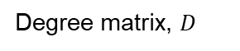
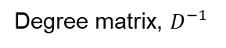
Simple Massage Passing
There are ways to tweak this. For example, we can take the average of the message rather than the sum.
What we need to do is to divide by the neighbour hood size of the nodes
We can make use of the degree matrix here, which is a diagonal matrix and the diagonal element is the sum of the nodes in each node.
1 | 0 | 0 | 0 | 0
0 | 2 | 0 | 0 | 0
0 | 0 | 3 | 0 | 0
0 | 0 | 0 | 1 | 0
0 | 0 | 0 | 0 | 1
1 | 0 | 0 | 0 | 0
0 | 0.5 | 0 | 0 | 0
0 | 0 | 0.3 | 0 | 0
0 | 0 | 0 | 1 | 0
0 | 0 | 0 | 0 | 1
Take inverse
Degree matrix, $D$
Degree matrix, $D^{−1}$

Slide 61
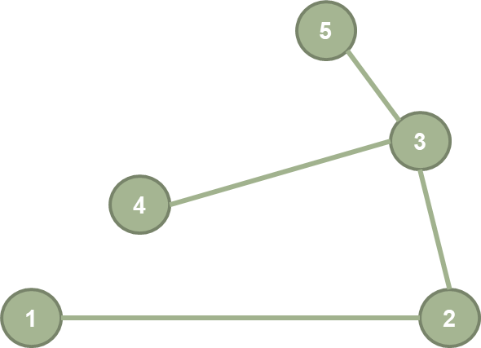
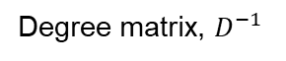
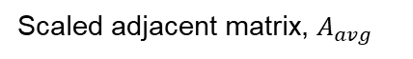
Simple Massage Passing
Then we multiply with adjacent matrix, we effectively assign a weight to each edge in the adjacent matrix such that each value in a row is divided by the neighbourhood size of that row.
1 | 0 | 0 | 0 | 0
0 | 0.5 | 0 | 0 | 0
0 | 0 | 0.3 | 0 | 0
0 | 0 | 0 | 1 | 0
0 | 0 | 0 | 0 | 1
0 | 1 | 0 | 0 | 0
1 | 0 | 1 | 0 | 0
0 | 1 | 0 | 1 | 1
0 | 0 | 1 | 0 | 0
0 | 0 | 1 | 0 | 0
0 | 1 | 0 | 0 | 0
0.5 | 0 | 0.5 | 0 | 0
0 | 0.3 | 0 | 0.3 | 0.3
0 | 0 | 1 | 0 | 0
0 | 0 | 1 | 0 | 0
=
Degree matrix, $D^{−1}$
Adjacent matrix, $A$
Scaled adjacent matrix, $A_{avg}$

Slide 62
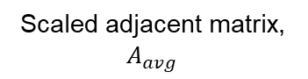
Simple Massage Passing
Notice that values in the nodes with connection will have values and values in the nodes without connection will become zero.
But now the values is taken as the average now.
0 | 1 | 0 | 0 | 0
0.5 | 0 | 0.5 | 0 | 0
0 | 0.3 | 0 | 0.3 | 0.3
0 | 0 | 1 | 0 | 0
0 | 0 | 1 | 0 | 0
1
2
3
4
5
0(1) + 1(2) + 0(3) + 0(4) + 0(5)
0.5(1) + 0(2) + 0.5(3) + 0(4) + 0(5)
0(1) + 0.3(2) + 0(3) + 0.3(4) + 0.3(5)
0(1) + 0(2) + 1(3) + 0(4) + 0(5)
0(1) + 0(2) + 1(3) + 0(4) + 0(5)
2
2
3.3
3
3
=
Scaled adjacent matrix, $A_{avg}$
Feature Vector
New Feature Vector (Average)

Slide 63
Simple Massage Passing
Other tweaks that relevant to graph convolutional networks
Add self connection to the adjacent matrix
When do neighbourhood aggregation, we include the information of the self nodes.
Comes from derivation of convolutional operation on graph.
Can make the graph numerically stable
5
3
4
1
2

Slide 64
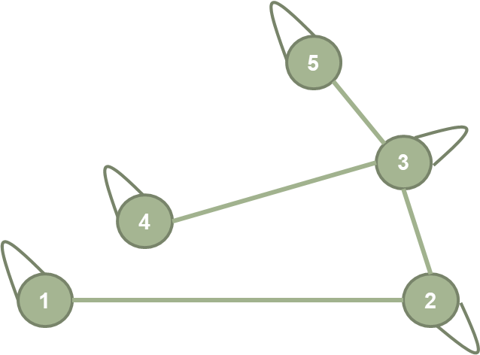
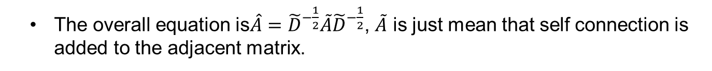
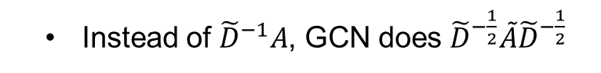
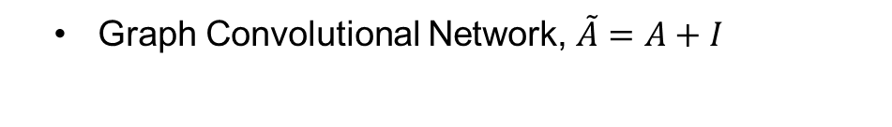
Simple Massage Passing
Graph Convolutional Network, $\tilde{A}=A+I$
Instead of ${\tilde{D}}^{−1}A$, GCN does ${\tilde{D}}^{−\frac{1}{2}}\tilde{A}{\tilde{D}}^{−\frac{1}{2}}$
Self connection
Scale by the neighbour size of the destination instead of source node
Expand it and the resulting matrix in element will be ${\hat{A}}_{ij}=\frac{1}{\sqrt{{\tilde{d}}_{i}{\tilde{d}}_{j}}}{\tilde{A}}_{ij}$
Normalizing by the neighbourhood size of both source, d_{i} and the destination, d_{j}
The overall equation is$\hat{A}={\tilde{D}}^{−\frac{1}{2}}\tilde{A}{\tilde{D}}^{−\frac{1}{2}}$, $\tilde{A}$ is just mean that self connection is added to the adjacent matrix.

Slide 65

Example
Look at a system when we pass message to every node repeated, what will happen to the node.
Water dropping experiment
5
1st iteration
3
4
1
2

Slide 66
Example
2nd iteration
5
3
4
1
2

Slide 67
Example
3rd iteration
5
3
4
1
2

Slide 68
Example
4th iteration – converge to steady state
5
3
4
1
2

Slide 69
Message Passing Summary
If we take a set of nodes and multiply with adjacent matrix, we effectively summing up the neighbourhood node
If we scaled the adjacent matrix by the neighbourhood size, we effectively taking the average
It is analogue to passing message to neighbour using different aggregation methods.
If we repeat the process, message can be passed further the entire graph.

Slide 70
References
https://aifrenz.github.io/present_file/A%20gentle%20introduction%20to%20graph%20neural%20networks.pdf
https://blog.zakjost.com/post/gcn_citeseer/

